Slide 1
Technology Hackathon 2025
Gen AI Orchestrator for Email and Document Triage/Routing
Team – AI Galaxy

Slide 2
Approach
Extract text from emails and attachments
Check for duplicates using Pinecone Vector DB
If not a duplicate - Classify Request types using Mistral AI
Extract key entities dynamically using LLM
Store new emails in Pinecone as vector embeddings
An Interactive UI is used to select the files and view the details regarding the email

Slide 3
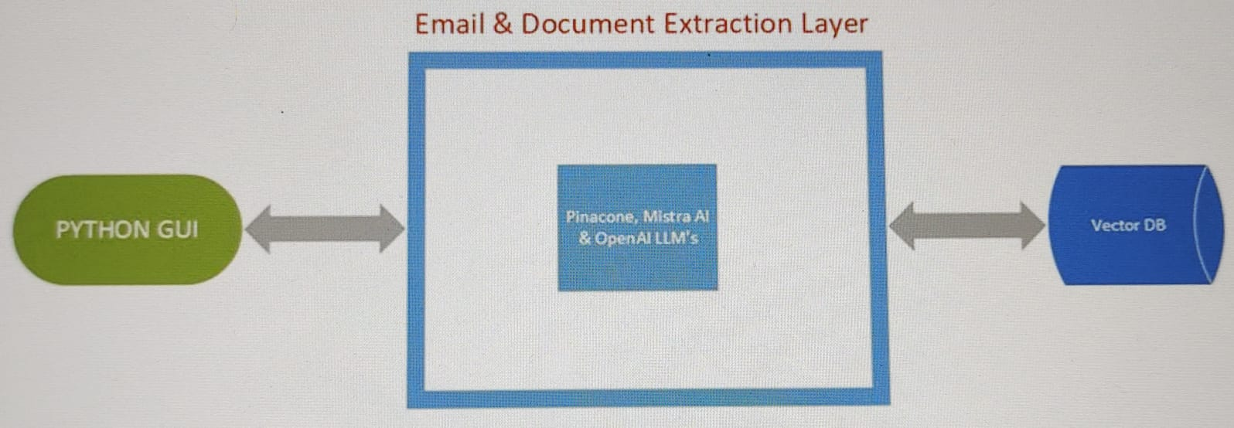
Architecture Diagram

Slide 4
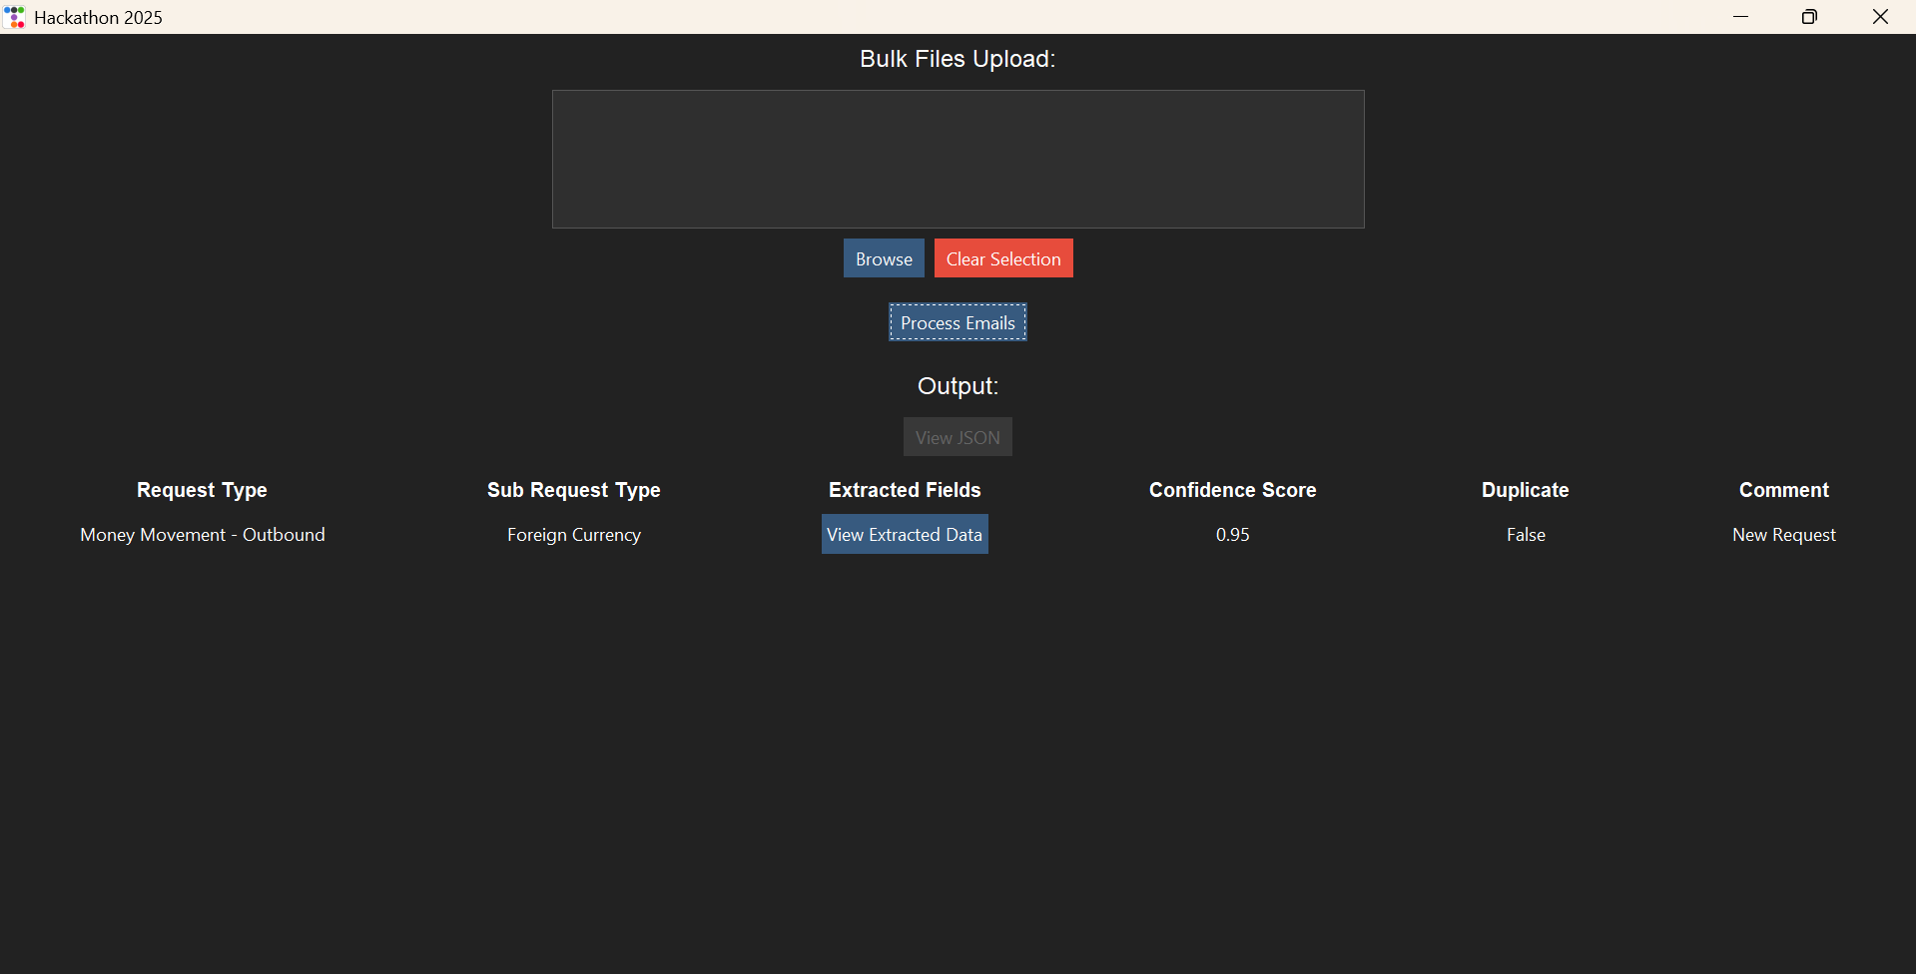
Screenshot – Valid Email (with High Confidence Score):

Slide 5
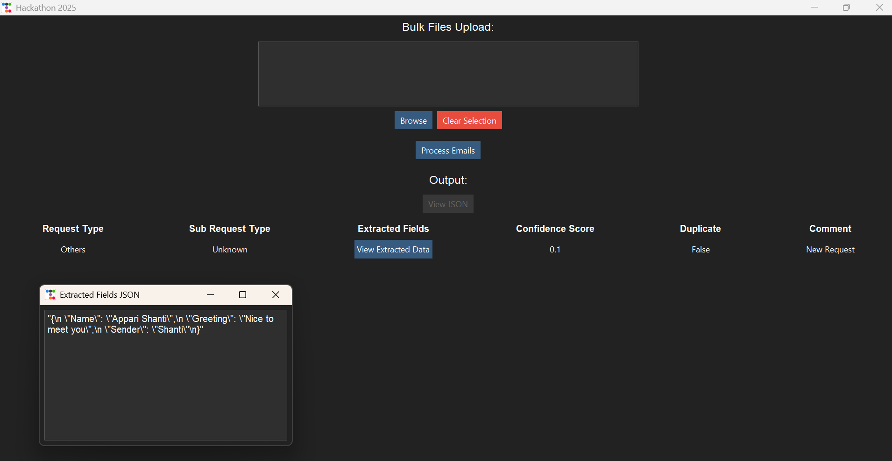
Screenshot – Email (with Less Confidence Score):

Slide 6
Detailed Overview:
Implement a Python UI which provides capabilities of Bulk uploading files(eml, pdf, docs) for User to Upload.
The provided file is then processed to get the text content extracted from it.
An Embedding model is used to create vector embeddings and used to query a vector db for any previously seen duplicates
If not a duplicate, the content is fed to a LLM pipeline which classifying it into predefined set of Request Types and Sub-Request Types
The same model is also used to extract important information from the mail as well as the attachments
Once we processed the uploaded files(eml, pdf, doc) we’re showing output as Request types along with Confidence score, Sub Request Types, Duplicate detection flag on UI

Slide 7
Technologies Used:
Python
LLMs - OpenAI, Mistral AI, Gemini
Pinecone – Vector DB
UI: Tkinter (Python)

Slide 8
Thank you

